Slide 1
ENVIRONMENT & SUSTAINABILITY | HACKATHON
SmartPlate AI
Predicted
420 meals
Cook what gets eaten,
not what gets wasted.
Cook 441 (+5% safety)
AI-powered food demand prediction for college canteens and hostels
HACKSPRINT
(ENKA R S, HASHINI O S, ROHINI S, DEVAMITHRA R G)

Slide 2
THE PROBLEM
Canteens cook by guesswork.
1
2
3
Guess in
No tracking
Waste out
Quantity is set from rough student strength or habit, not data.
Prepared vs. eaten is rarely recorded, so waste stays invisible.
Over-cooked food means lost money, wasted resources and emissions.
Hostels and canteens serve the same students daily, yet their consumption history is never used.

Slide 3
SCOPE
What we cover, and what we do not.
In this version
Future versions
Web app for canteens and hostel messes
Data entry with validation
AI demand prediction + quantity advice
Waste tracking, alerts, dashboards
Feedback loop from new data
IoT sensors for leftovers
Camera-based waste detection
Weather integration
Mobile app
Inventory integration

Slide 4
OBJECTIVES
One goal, five measurable steps.
Predict food demand with AI and reduce canteen food waste.
1
Design validated data entry (consumed cannot exceed prepared)
2
Develop a Random Forest demand model
3
Implement quantity advice with a safety margin
4
Implement waste % tracking and alerts above a threshold
5
Evaluate with MAE and RMSE against a baseline

Slide 5
LITERATURE SURVEY
Existing work and its limits.
Work | Method | Limitation
Rodrigues et al., 2024 | Random forest, LSTM; 14-52% fewer wasted meals | Forecast only; no tracking or alerts
Türker, 2025 | Six regression models on campus data | Model comparison; no user tool reported
Aci & Yergök, 2023 | 18 models, calendar effect, no pre-booking | One refectory; no waste monitoring
Faezirad et al., 2021 | Neural network on meal reservation data | Needs pre-booking data
Sundar et al., 2023 | 12 ML models for food demand | General data; no canteen workflow
Winnow Vision, 2019 | Camera + smart scales for waste | Hardware needed; no demand prediction

Slide 6
RESEARCH GAP
Forecasting alone is not enough.
Existing work
SmartPlate AI adds
Mostly forecasting models
Hardware-based waste measurement
Often needs meal pre-booking
Rarely a simple staff-facing tool
Prediction + quantity advice
Prepared vs. eaten tracking
Alerts and feedback loop
Low-cost web app, no pre-booking

Slide 7
OUR SOLUTION
A loop that gets smarter every meal.
1
2
3
4
5
Past data
AI predicts
Cook quantity
Record actuals
Learn
Attendance, menu, day, exams
Random Forest demand
Prediction + safety margin
Prepared vs. consumed
New data retrains model

Slide 8
KEY FEATURES
Everything a canteen manager needs.
Prediction
Quantity advice
Waste tracking
Meals needed for any date and meal
Prediction plus configurable safety margin
Waste and waste % after every meal
Smart alerts
Trend dashboard
Eco score
Warns when waste crosses the threshold
Charts of consumption and waste
Food waste avoided over time

Slide 9
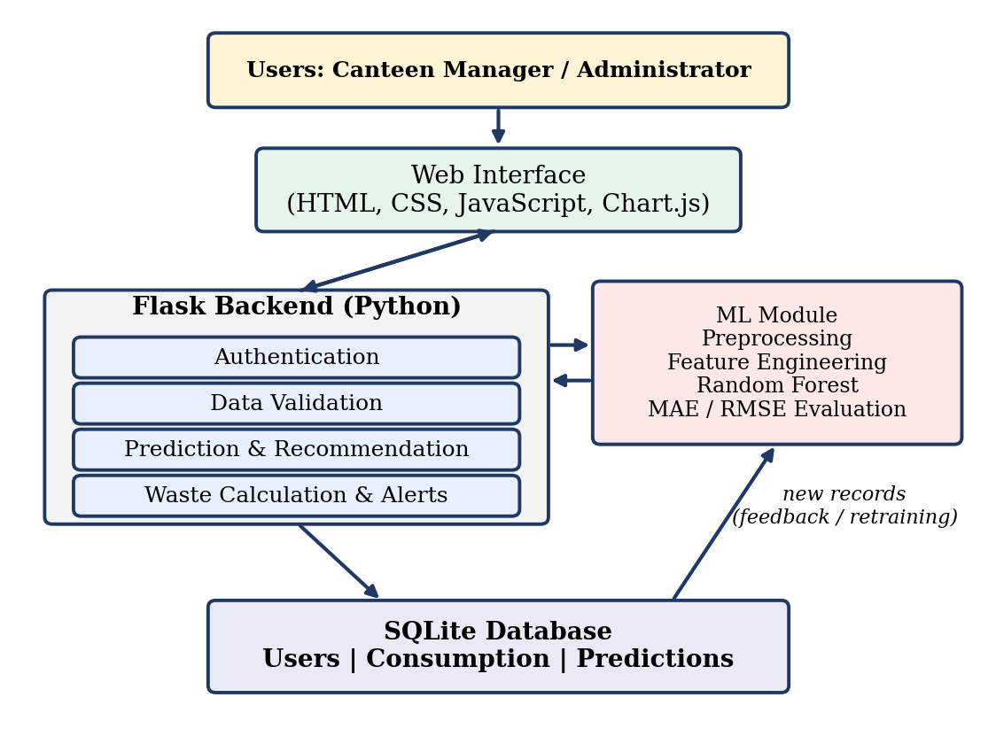
ARCHITECTURE
Four layers, one clean data loop.
Web interface
Dashboard for managers and admins
Flask backend
Login, validation, prediction, waste and alerts
ML module
Features, Random Forest, MAE / RMSE
SQLite database
Users, consumption, predictions

Slide 10
HOW THE AI WORKS
Simple, explainable, accurate.
Inputs
Random Forest
Day of week and meal type
Student attendance
Menu served
Holiday and exam period
Previous and average consumption
Handles tabular data and non-linear patterns. Tested on recent data and scored with MAE and RMSE against a weekday-average baseline.
Cook = Prediction x (1 + margin)

Slide 11
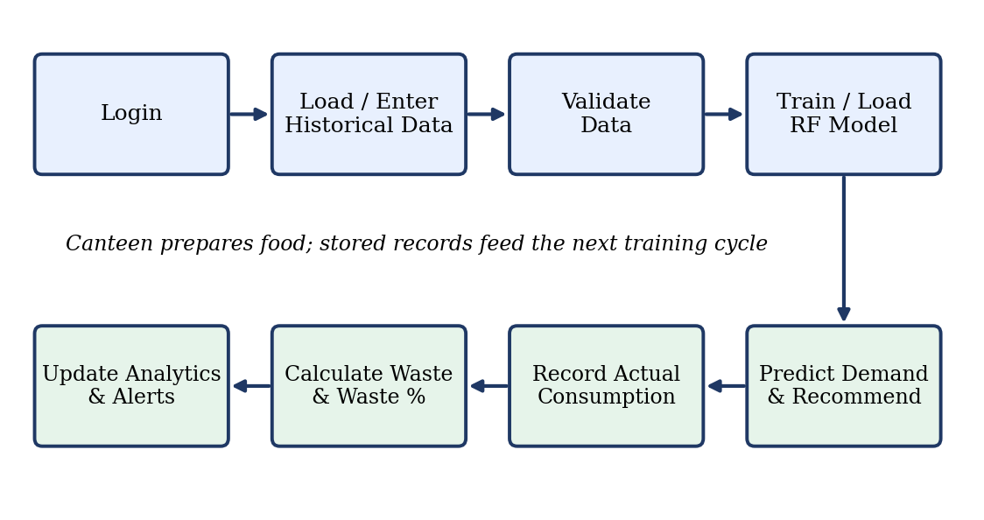
WORKFLOW
From login to a better next prediction.

Slide 12
REQUIREMENTS
Clear, testable, measurable.
Functional (16)
Non-functional (8)
Secure login and roles
Data entry with validation
Predict demand, advise quantity
Waste %, alerts, analytics
MAE / RMSE and retraining
Prediction within 5 seconds
Pages load within 3 seconds
Hashed passwords, role access
Chrome and Edge support
95% uptime in canteen hours

Slide 13
IMPACT & ROADMAP
Less waste today, scalable tomorrow.
Tech stack
Future scope
Flask | Scikit-learn | Pandas | SQLite | Chart.js
IoT weighing sensors
Weather integration
Mobile app, multi-canteen
Ingredient-level prediction
Inventory and surplus-food links
Impact
Lower food cost and overproduction
Measured, visible waste
Sustainable campus dining

Slide 14
Cook smarter.
Waste less.
Thank you

